Slide 3
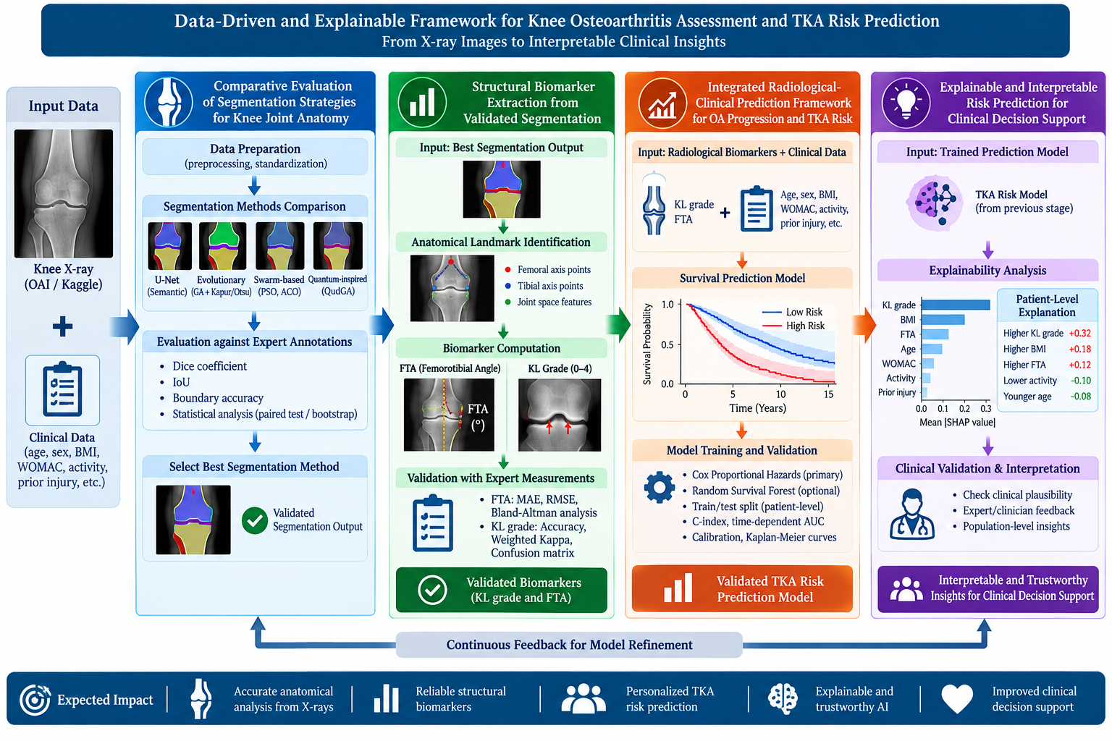
Methodology

Slide 4
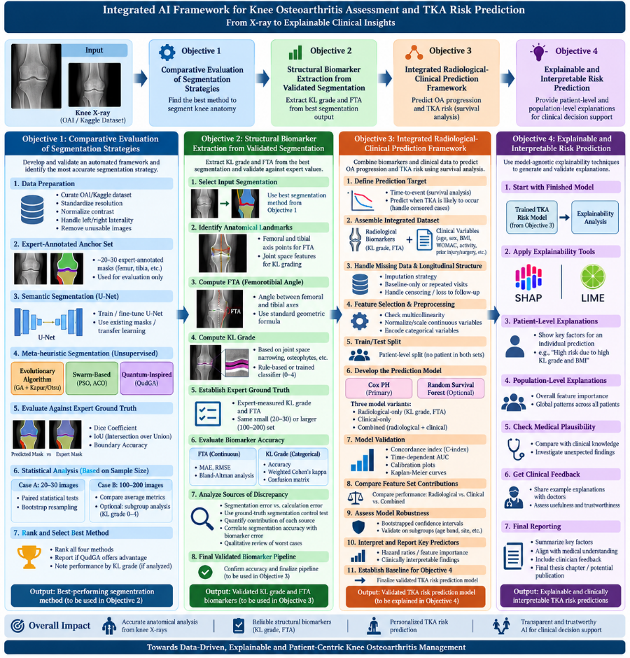

Slide 5
Mapping of Research Objectives to Methodology and Evaluation
Research Objective | Input | Key Methods / Techniques | Output | Evaluation Parameters / Validation
Objective 1: Automated Segmentation of Knee Joint Anatomy | Knee X-ray radiographs | Semantic; Evolutionary algorithms with Kapur/Otsu objective functions; Swarm-based methods such as PSO/ACO; Quantum-inspired QudGA | Validated anatomical segmentation and best-performing segmentation strategy | Dice coefficient, IoU, Boundary Accuracy; paired statistical testing and/or bootstrap resampling for small expert set; subgroup analysis where applicable
Objective 2: Automated Structural Biomarker Extraction | Best segmentation from Objective 1 | rule-based or trained classification for KL 0–4,;Anatomical landmarks; geometric calculation for FTA | Validated FTA and KL grade | KL: Accuracy, weighted Cohen's κ, confusion matrix. Additional error attribution using expert/ground-truth segmentation control and correlation with segmentation quality.,FTA: MAE, RMSE, Bland–Altman analysis.
Objective 3: Integrated TKA Risk Prediction | Validated KL + FTA + age, sex, BMI, pain/functional scores, physical activity, prior injury/surgery + longitudinal TKA outcome | Cox Proportional Hazards as primary interpretable model; optional Random Survival Forest; three models: radiological-only, clinical-only, combined | Validated future TKA risk / time-to-TKA prediction model | C-index, time-dependent AUC, calibration plots, Kaplan–Meier curves, bootstrap confidence intervals; comparison of radiological-only vs clinical-only vs integrated model.
Objective 4: Explainable and Interpretable Risk Prediction | Validated TKA-risk model from Objective 3 | SHAP / LIME; feature contribution analysis | Patient-specific and population-level explanations of TKA risk | Feature contribution consistency, clinical plausibility, agreement with established medical understanding, and expert/clinician feedback on usefulness and trustworthiness.

Slide 6
Expert Collaboration
Segmentation: Anatomical masks
FTA: Expert angle measurement
KL: Expert grade 0–4
Reliability

Slide 7
Dataset
*/ Master Repository
Direct repository
  Official NIH/NDA OAI repository:
  Osteoarthritis Initiative — NIH/NDA
Existing image/KL derivative:
Knee Osteoarthritis Severity Grading Dataset — Mendeley Data
/*
Used Repository from Master Repository
Kaggle version :
Knee Osteoarthritis Dataset with Severity Grading — Kaggle
Reference Ground Truth Mask for UNET https://github.com/yaufan/Knee_Segmentation_Database

Slide 8
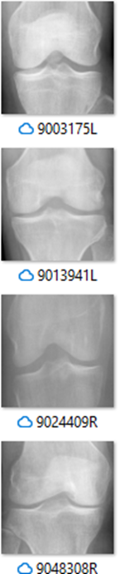




Knee Osteoarthritis Dataset with
Severity Grading
Study Population
Osteoarthritis Initiative (OAI): prospective, longitudinal, multi center observational study.
9500+XRAY images (Left and Right Knee) ,4,796 participants, approximately 45–79 years at enrolment.
Includes knees with established OA and knees at risk of developing OA.
Repeated assessments over several years enable cross-sectional and longitudinal analysis.
Data Modalities Used in Research
1. Radiographic / Imaging Data
Weight-bearing knee radiographs
KL grade: 0–4
Radiographs linked to participant, knee laterality and visit
Clinical / Demographic Data in .CSV file
Age
Sex
BMI
Pain and functional scores
Physical activity
Previous knee injury/surgery
etc
Sample images KL 0- KL 4

Slide 9
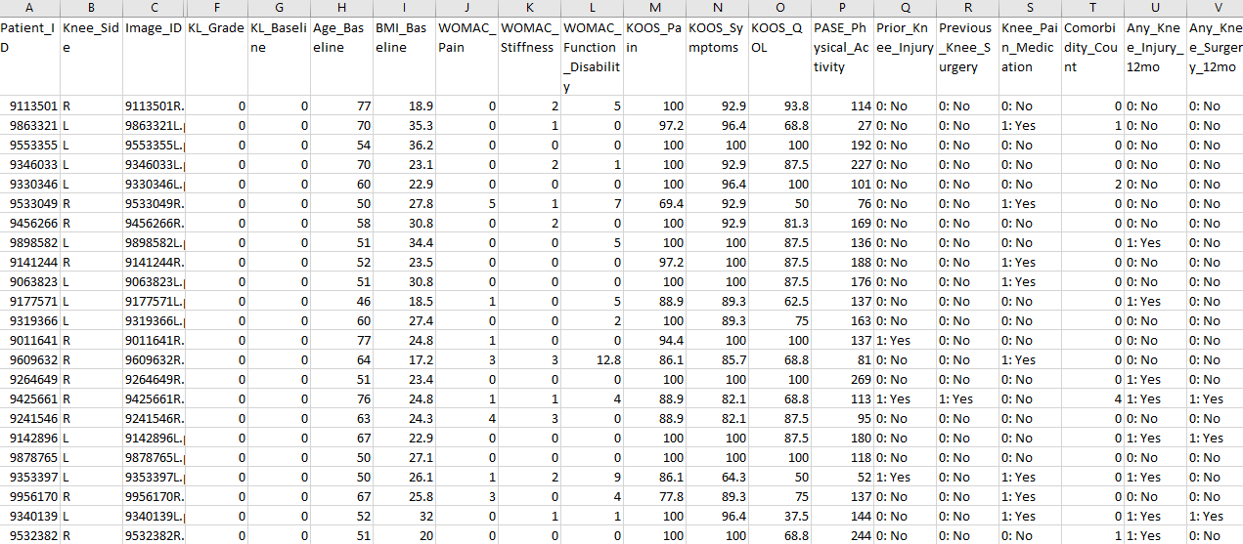

Slide 10
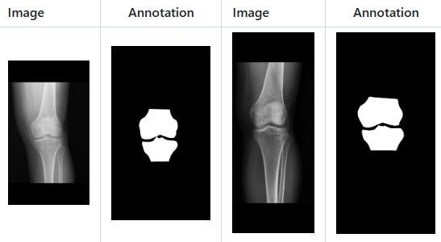
Knee Segmentation Database with Mask
CGMH Knee_Segmentation_Database
With Ground Truth Mask
for UNET based segmentation ,can be useful in FTA calculation https://github.com/yaufan/Knee_Segmentation_Database
Knee X-ray image data and corresponding Femur and Tibia segmentation information
The database includes anteroposterior knee radiograph assessments of 400 participants in Chang Gung Memorial Hospital.
Femur and Tibia segmentation information was determined by using the BoneFinder tool by author of the database (http://bone-finder.com).
  Range for Image size: (1300 ~ 3400) x (800 ~ 2500)
  Images type: PNG (8 Bit).
  X-ray Images Channel: 3.
  Label Images Channel: 1.

